Slide 1
Tanzania Pump Prediction
By: Ranaldo Slowley

Slide 2
Overview
Predicted the operating condition of a waterpoint for each record in the dataset.
The data had 59400 Rows and 41 columns, and I cut it down to 18 columns
Very dirty data

Slide 3
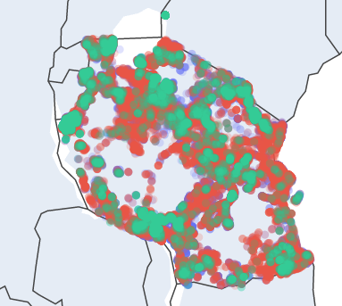


Slide 4
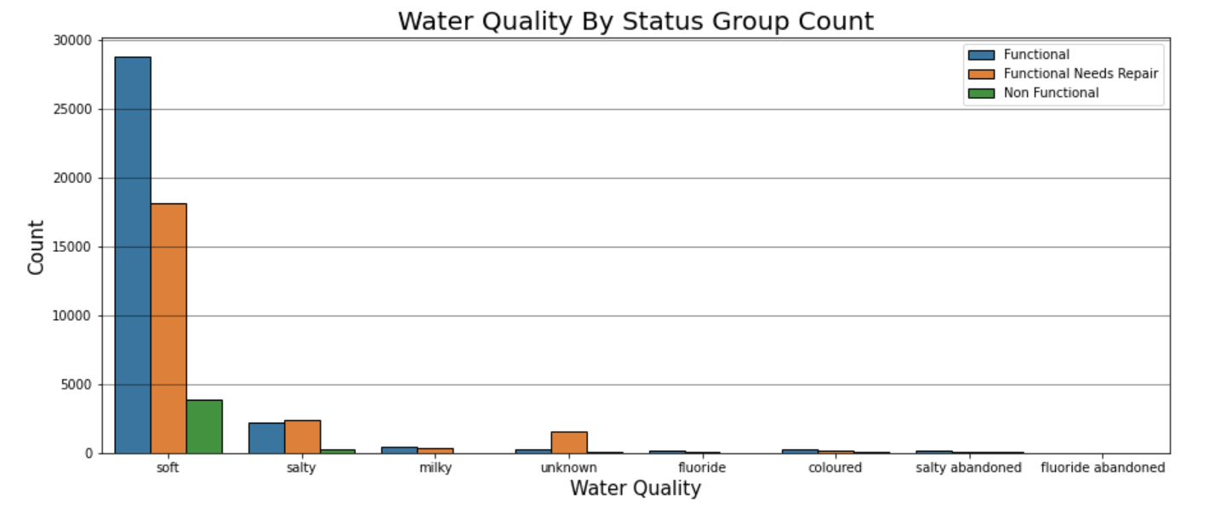

Slide 5
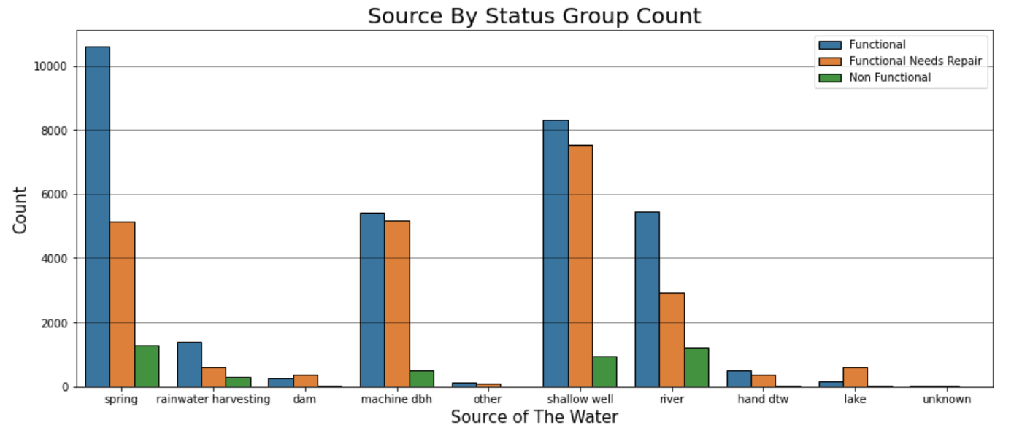

Slide 6
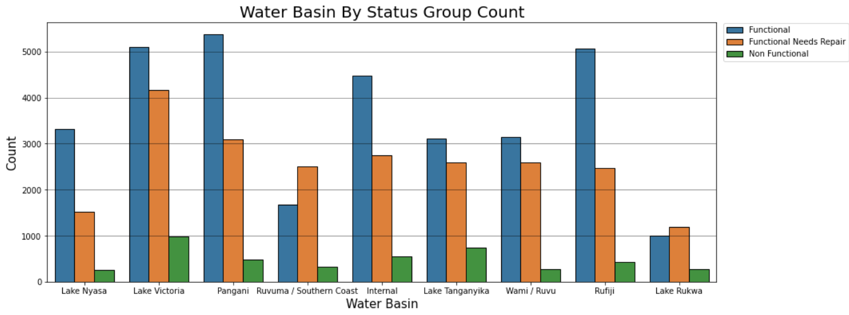

Slide 7
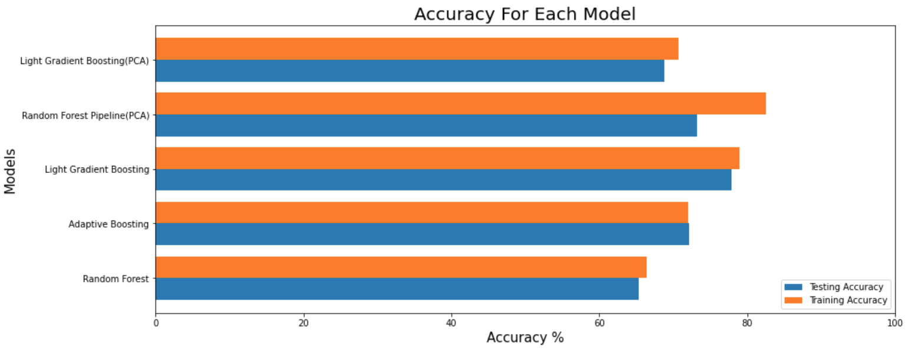

Slide 8
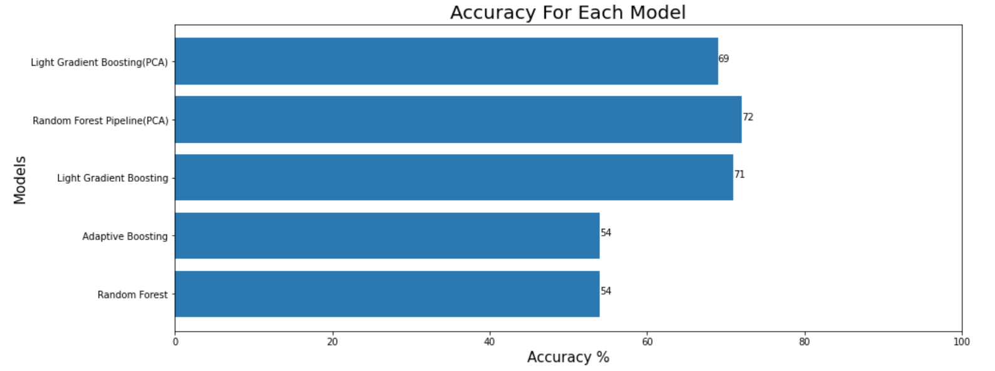

Slide 9
Results
Although Random Forest with 3 components has the best accuracy with 72% the model is a little overfit. Therefore, I will pick Light Gradient Boosting as my selected model because it does not overfit and has a 71% accuracy.

Slide 10

Recommendations
Lakes and Dams sources of water
Unknown and Salty water quality
Ruvuma and Lake Rukwa water basins

Slide 11
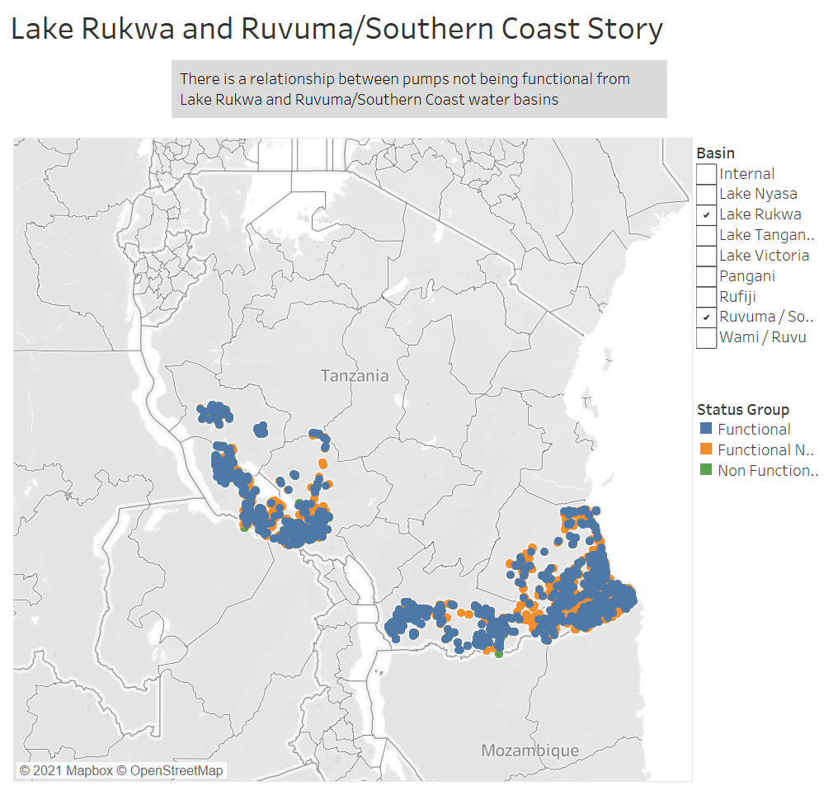

Slide 12
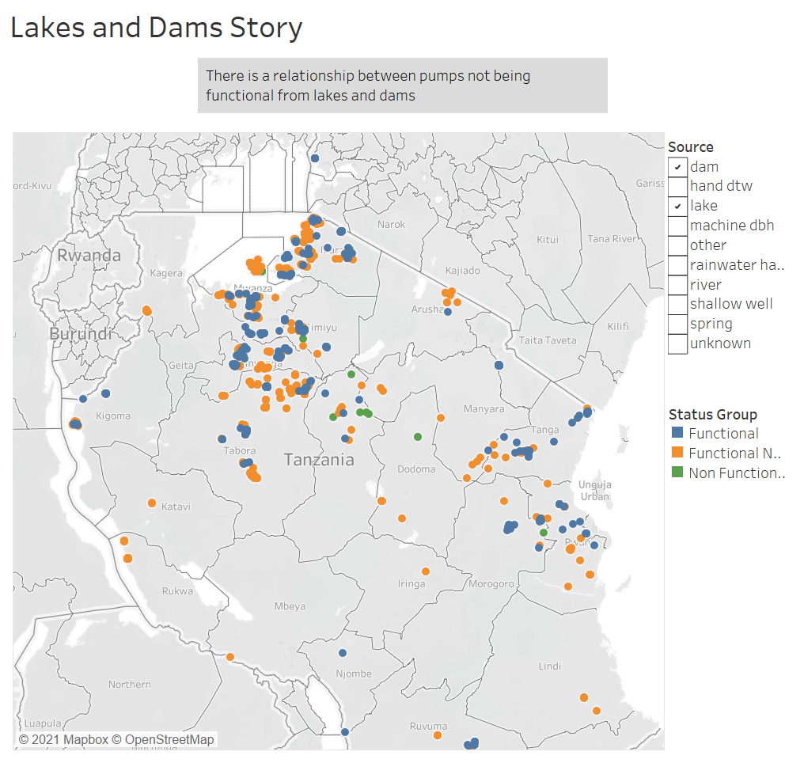

Slide 13
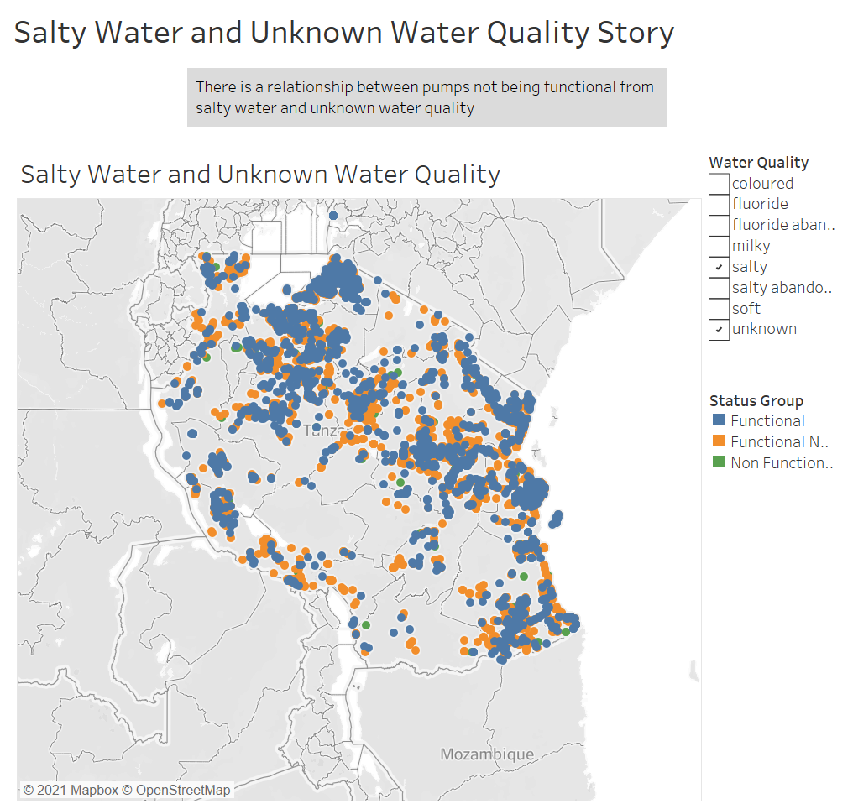

Slide 14

Questions?

